Slide 1
Project Update
ZHIYONG LIU

Slide 2
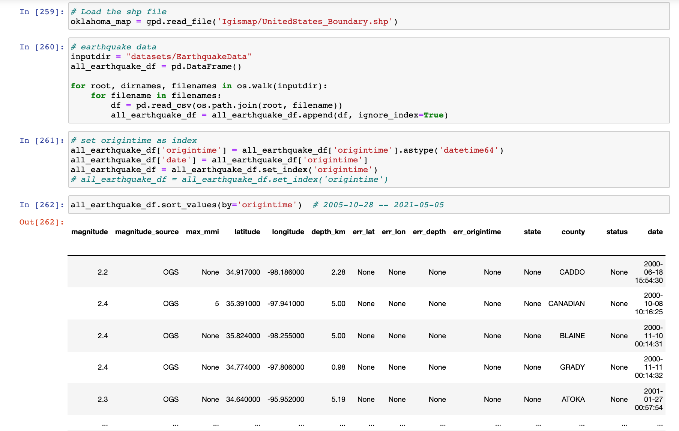
1. Dataset Processing
This month I first imported dataset and processed them.
The datasets in here used are WellData, OCC_injection_data, EarthquakeData

Slide 3
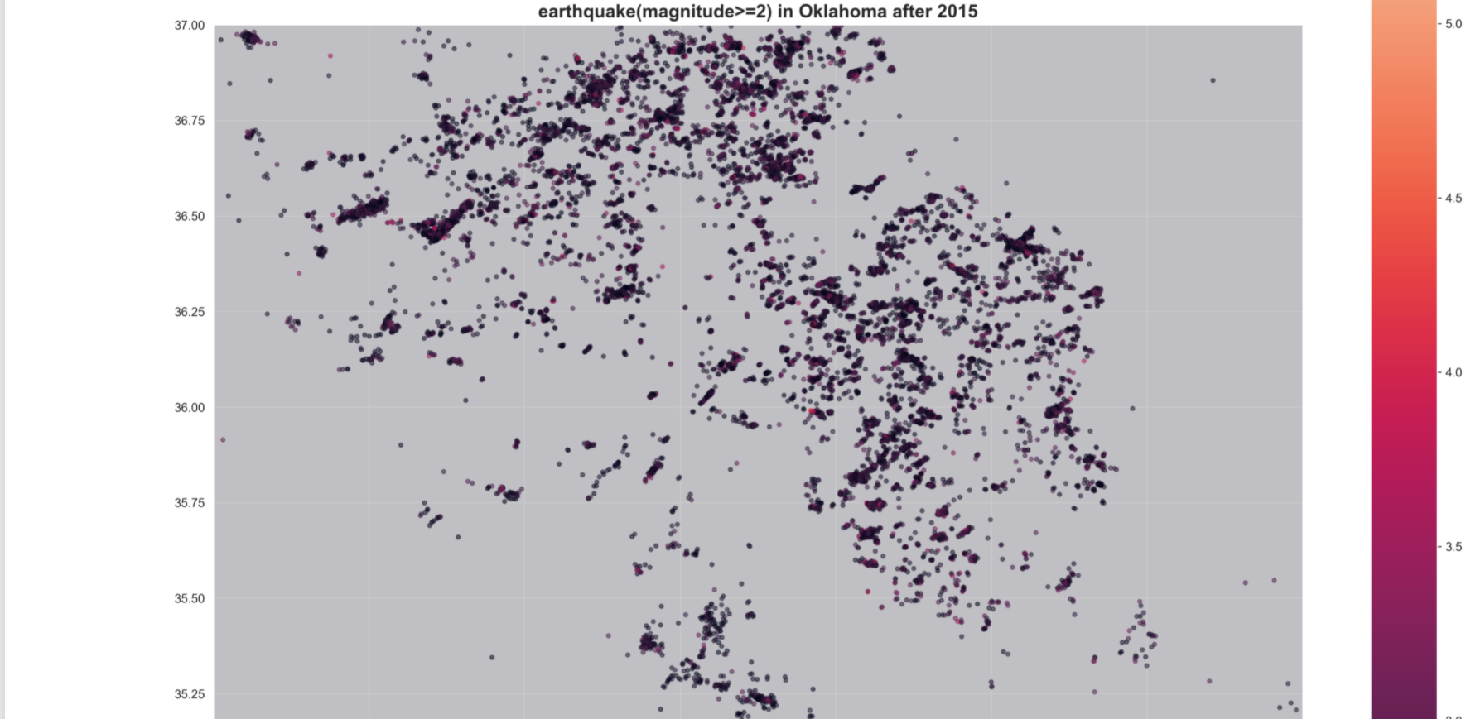
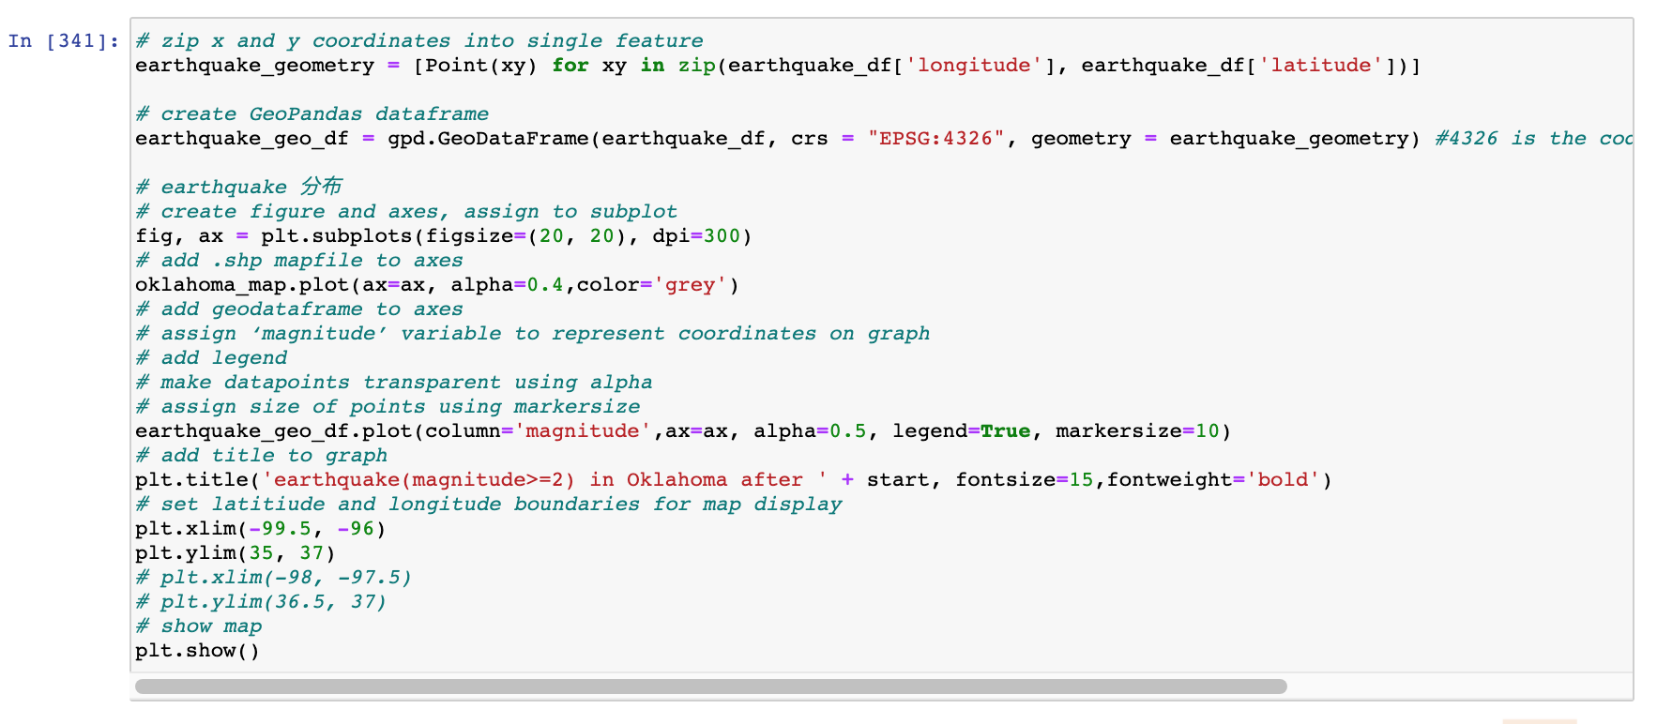
2. Mapping

Slide 4
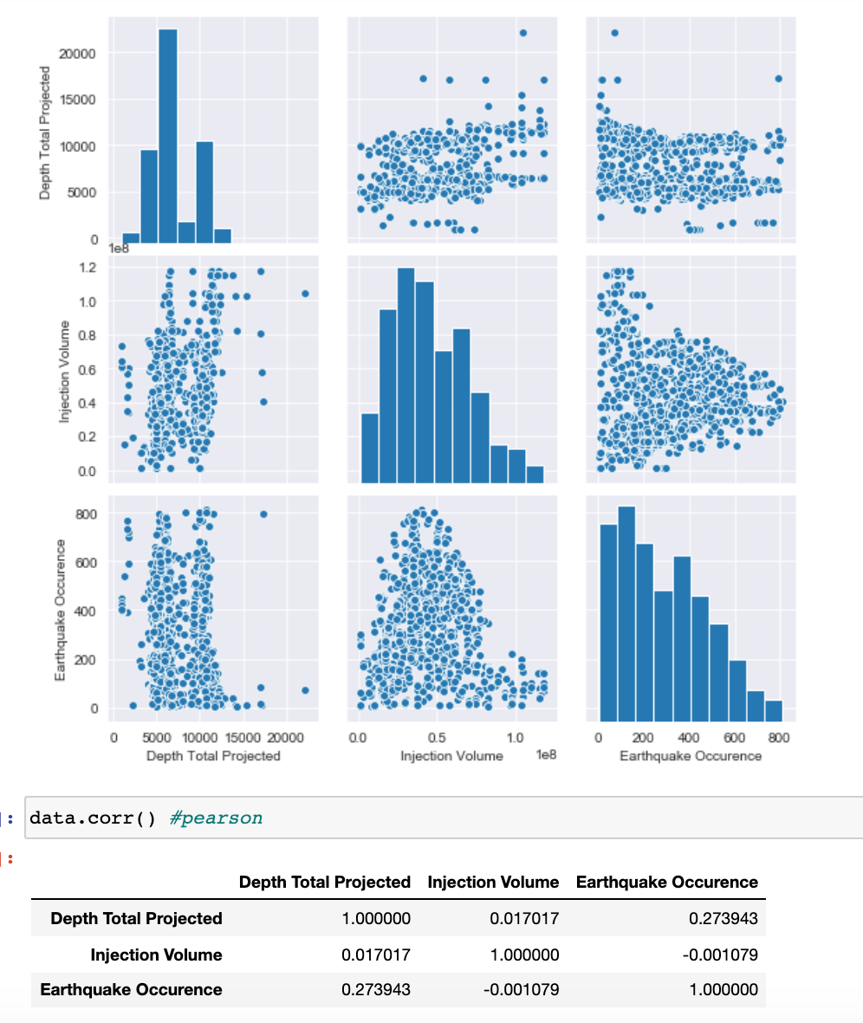
3. Correlation
Process:
1. look at each well and then search some radii distances around each well and to see if is there a possible correlation between injection volume and earthquake occurrence times used for certain radii value
2. Use the pair plot and Pearson coefficient to analyze

Slide 5
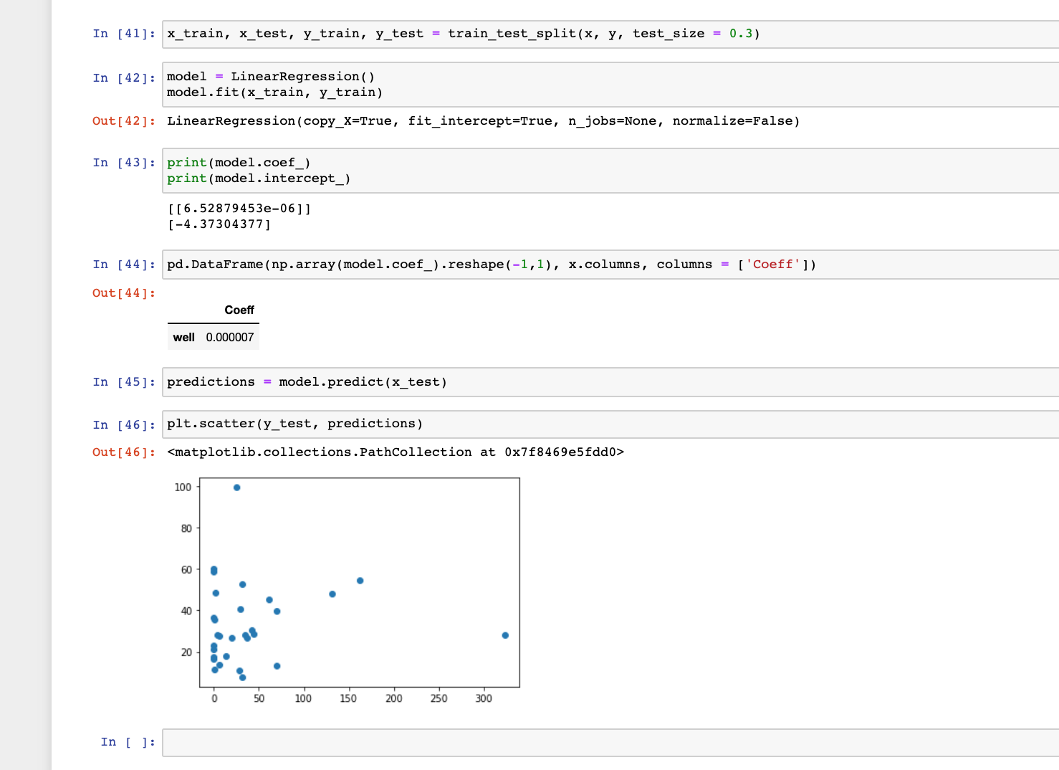
4. Linear Regression Model
I also generated a Linear Regression for predict the earthquake occurrence times in some region. Because the parameter selected in last part did not show an ideal correlation, so the model did not perform well

Slide 6
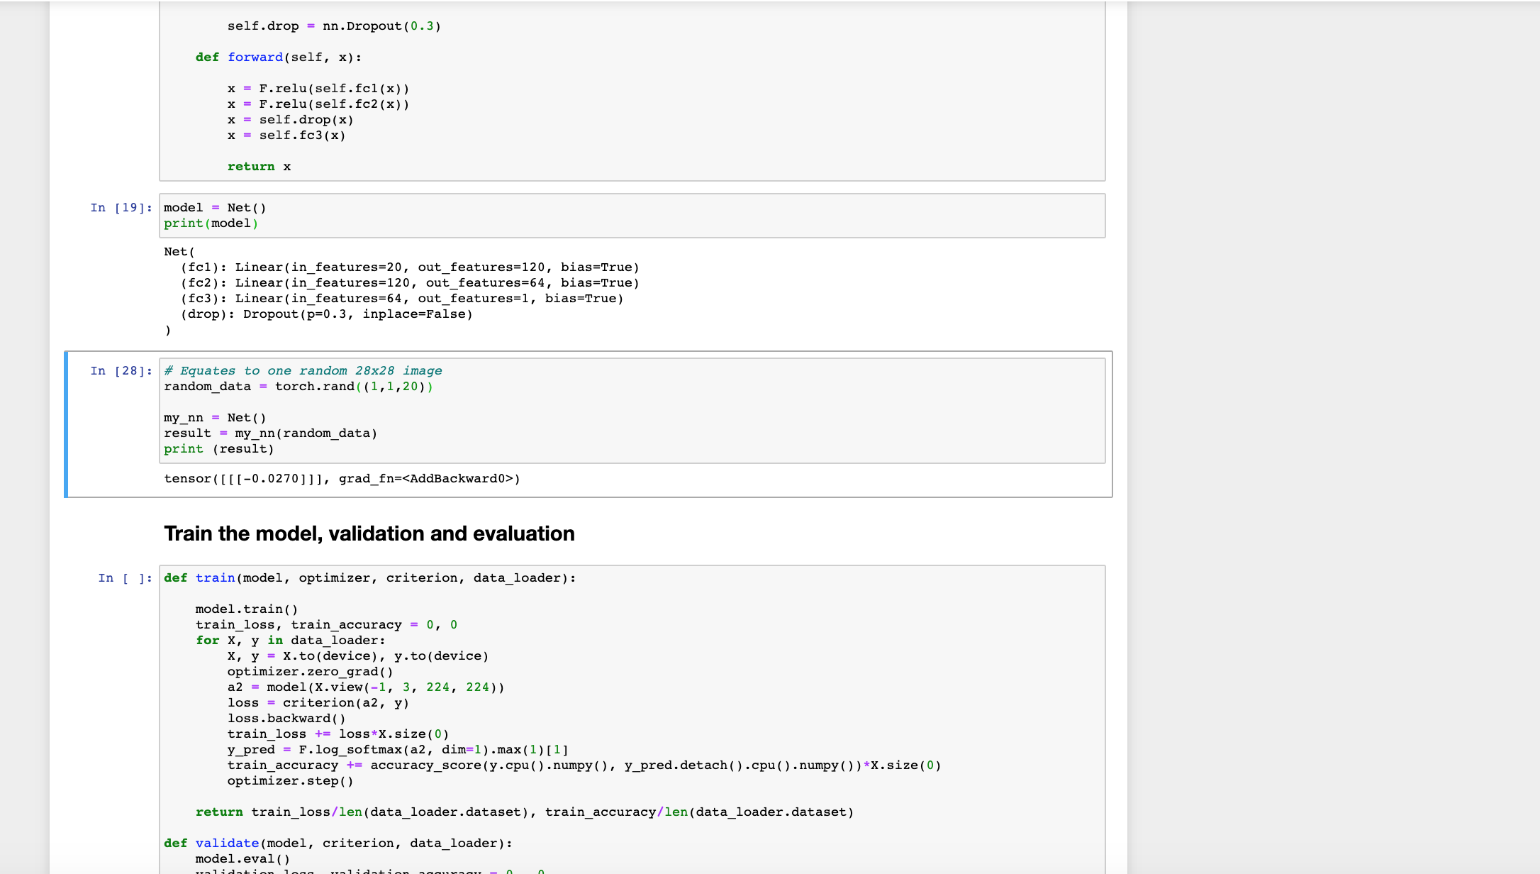
5. Neural Network Model
I also have implemented a simple neural network model and finished the train and test frame. Because the potential parameters in last past should be adjusted again, I did not write the dataset split code. This part I will concentrate after I finding an ideal correlation with earthquake and some potential parameters.

Slide 7
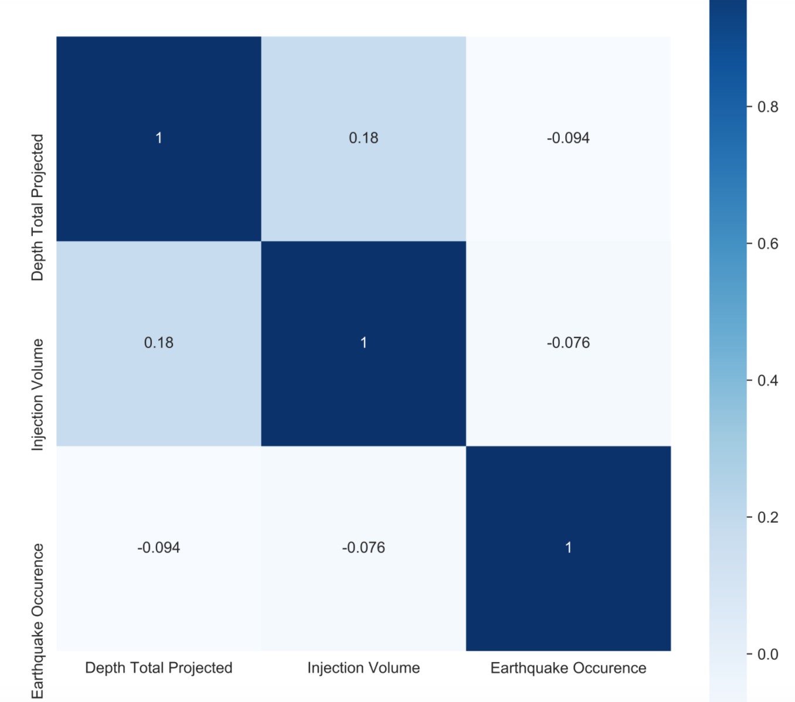
Current Correlation Problem
The data range and radius around each well chosen to construct the dataset may not be suitable, which cause the pair plot do not show a clearly linear correlation and the Pearson coefficient is not ideal. (In my investigating process, there exist a attempt which injection volume and earthquake occurrence has a linear relationship)
confusion matrix

Slide 8
Next To Do
I will also try another method: Look at each earthquake and then search some radii distances around each earthquake and to see if is there a possible correlation between injection volume and well used for certain radii value.
Do the data construction and split for the neural network model, then train and test.

